Slide 1

Analyzing Dairy Industry: Trends, Types and Consumption Patterns in Ontario.
DAB-303- Final Project
Created by: Rituraj Borah

Slide 2

Project Overview
This project aims to analyze various aspects of the dairy market, including sales trends, seasonal patterns, type comparisons, market share, and consumption habits.
Dataset detail:
The below four datasets are sourced from Statistic Canada websites.
Milk production and utilization
Commercial sales of milk and cream
Per person consumption over the years
Cash receipts from milk and cream sold off farms
Expected Outcomes:
Strategic Insights: Drive informed decisions with valuable market trend insights.
Improved Planning: Support production, inventory, and market positioning for dairy farms.
Informed Policies: Offer data-backed insights for effective dairy industry policymaking.

Slide 3
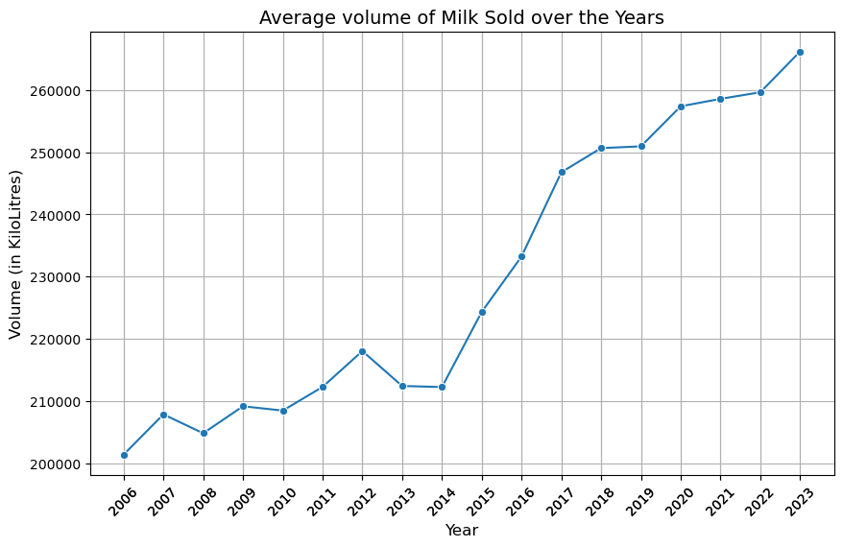
Analysis_1: Volume of milk sold over the years
Insights:
Substantial increase in milk sales from 2014 to 2018.
Post-2018, the growth in sales volume appears to have slowed compared to the preceding four-year period.
Recommendations:
Investigate factors causing the post-2018 sales slowdown.
Implement targeted marketing efforts for sales revitalization.

Slide 4
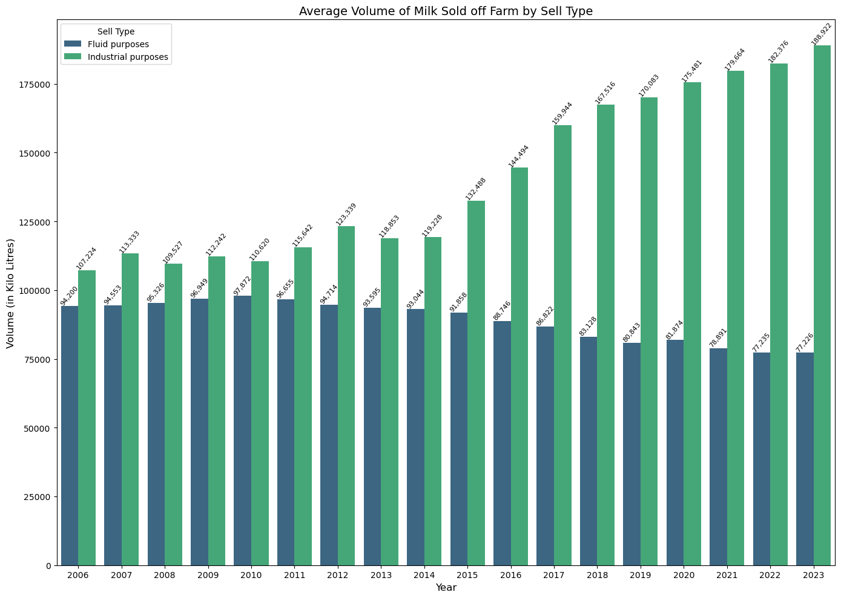
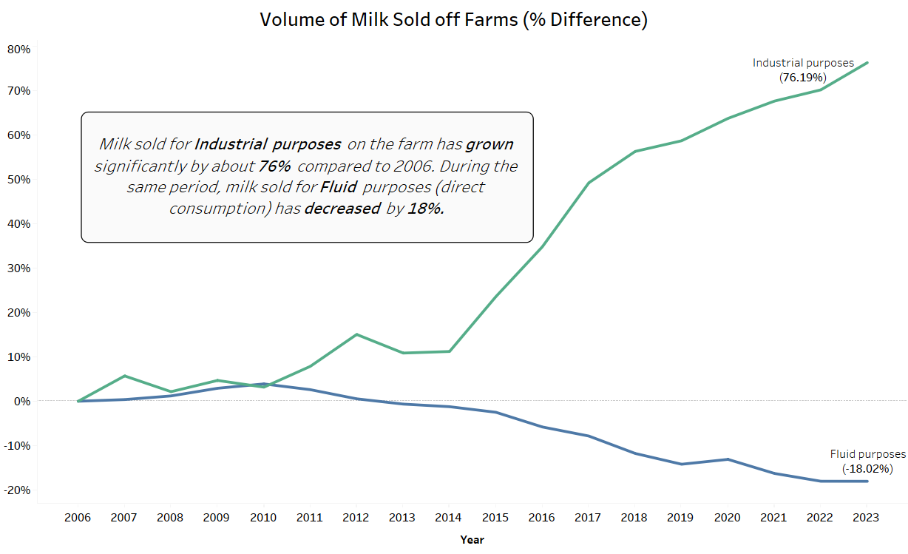
Analysis_2: Milk production and utilization
Insights:
Sales of Milk for Industrial purposes have grown significantly by 76.19% in 2023 compared to 2006.
Sales for Fluid purposes decreased by 18.02% during the same period.
Recommendations:
Capitalize on the growing demand for Industrial purposes by expanding and optimizing production for industrial use.
Implement targeted promotional campaigns or discounts to stimulate demand for Fluid milk products.

Slide 5
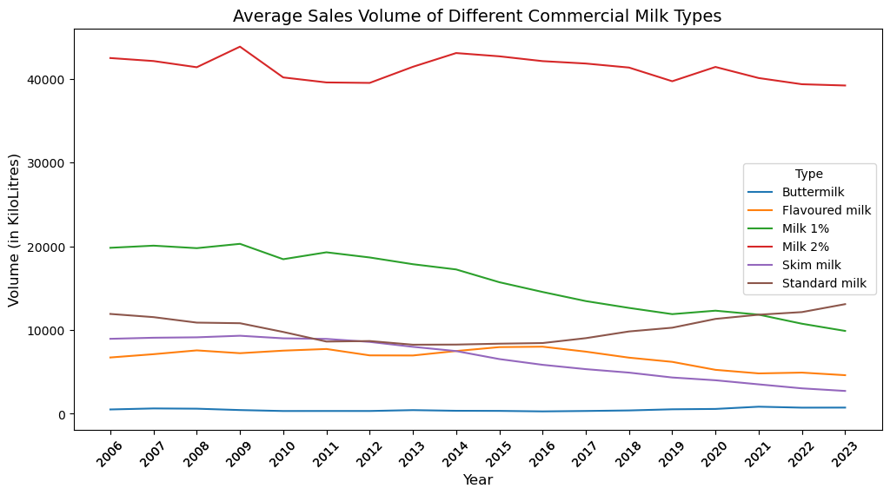
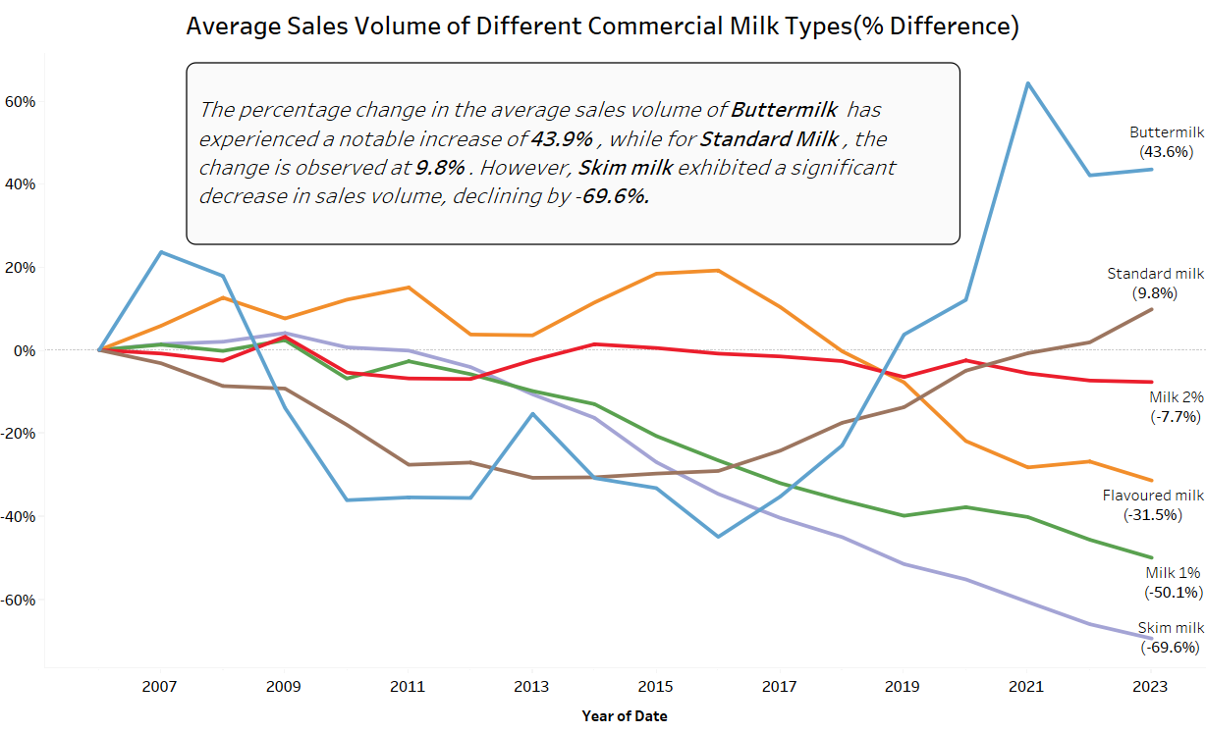
Analysis_3: Commercial sales volume of different milk types
Insights:
Milk 2% type have the highest volume of sales whereas Butter Milk has the lowest sale volume.
In term of percentage change, Buttermilk has experienced a notable increase of 43.9% in 2023 compared to 2006.
Recommendations:
Leverage Success: Utilize increase in Buttermilk sales by implementing targeted promotions and marketing strategies.
Address Decline : Evaluate factors contributing to the negative % changes in other milk products to reverse the declining trend.

Slide 6
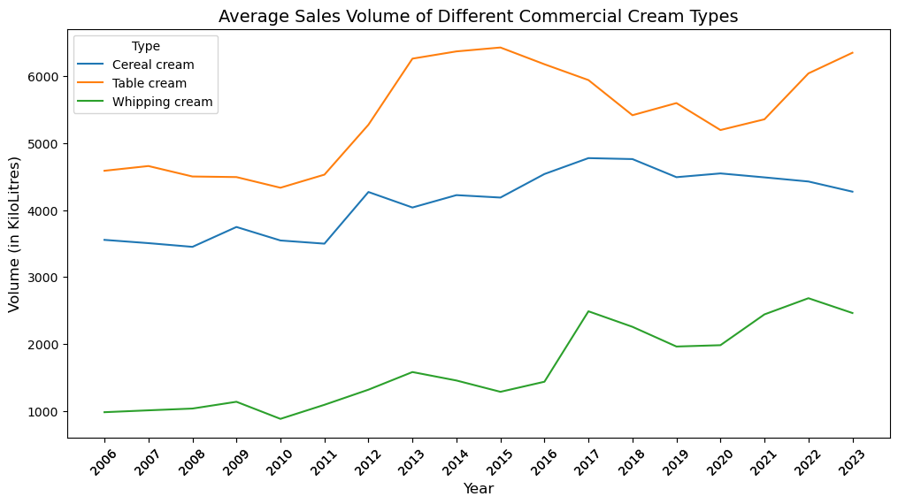
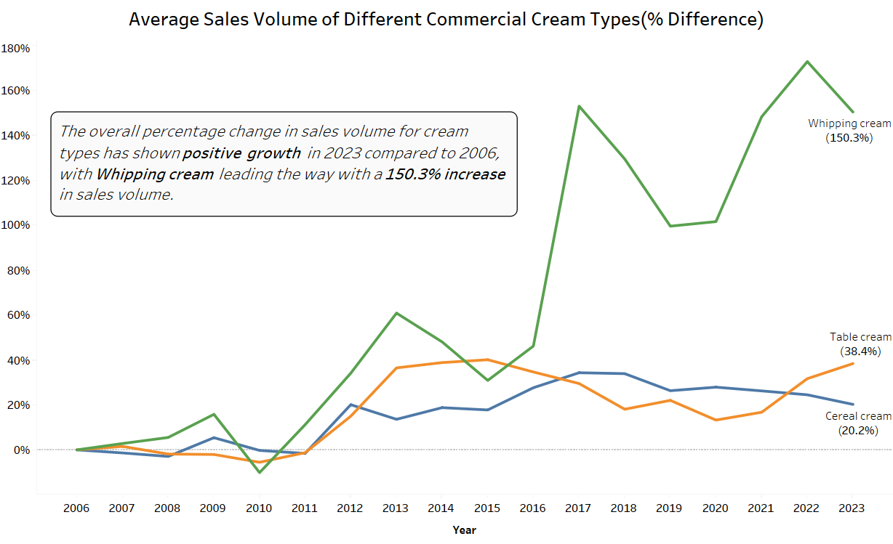
Analysis_4: Commercial sales volume of different cream types
Insights:
Table cream have the highest volume of sales whereas Whipping cream has the lowest over the years.
In term of percentage change, Whipping Cream is way ahead with 150.3% increase in sales volume compared to 2006.
Recommendations:
Utilize effective marketing to sustain the substantial sales growth of Whipping cream
Introduce new variants or packaging to maintain the sales of overall cream products.

Slide 7
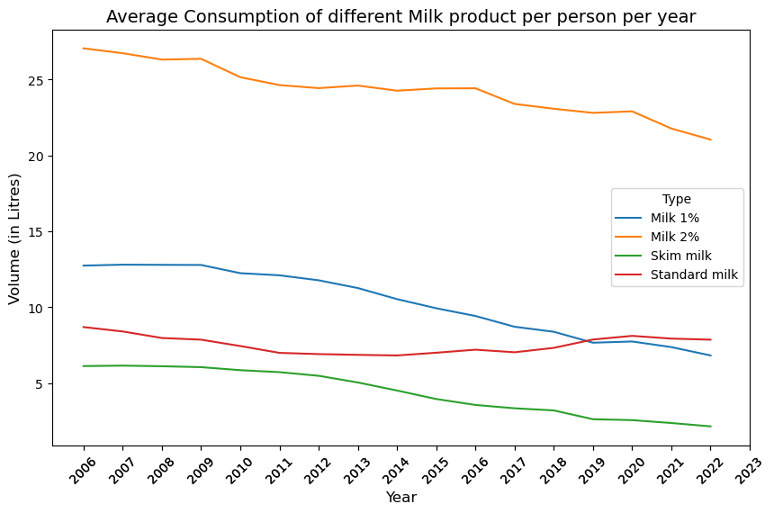
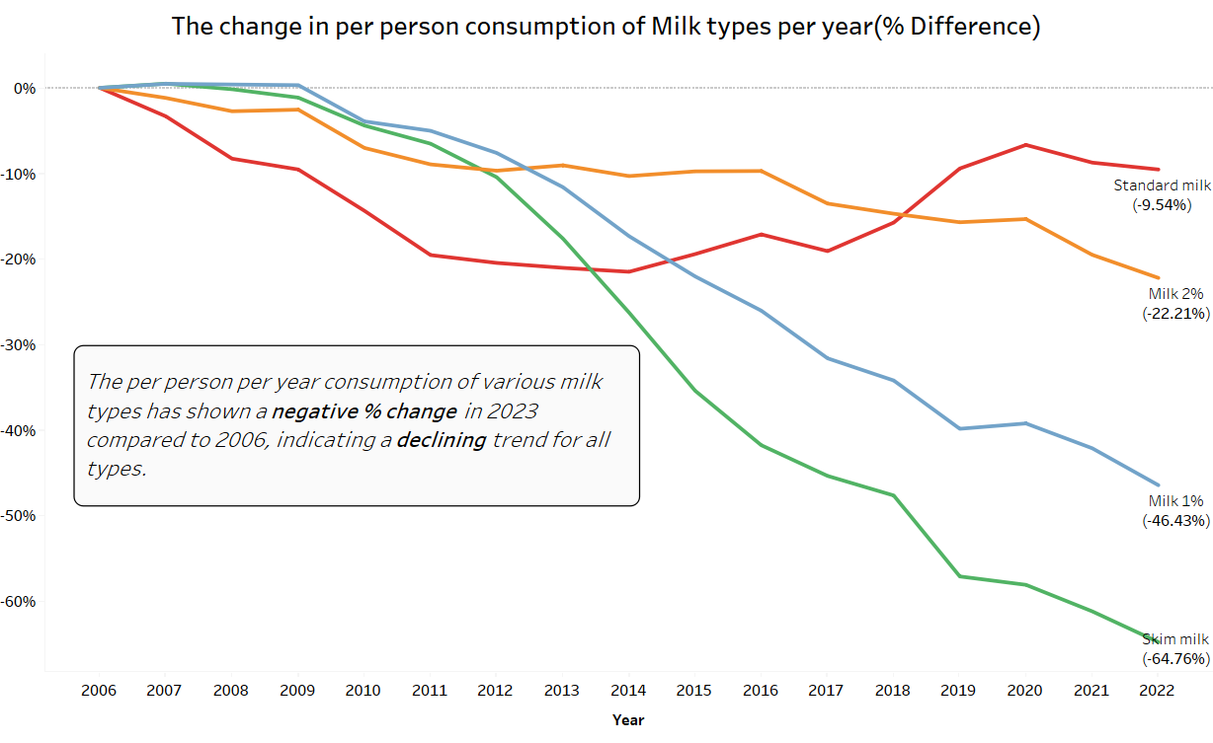
Analysis_5: Per Person consumption of different Milk product
Insights:
Milk 2% is the highest-consumed product per person, while Skim milk is the lowest.
Consumption volumes for most types except Standard Milk have exhibited a declining trend.
Recommendations:
Boost Standard Milk: Encourage higher consumption of Standard Milk for sustained growth and enhance overall milk consumption.
Diversify Products: Explore strategies to address the declining trend in other milk types and adapting to changing consumer preferences.

Slide 8
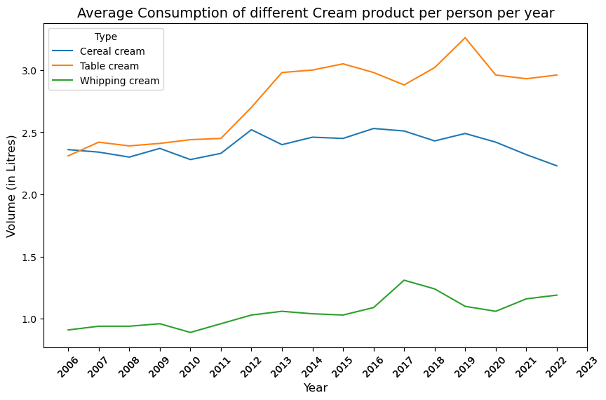
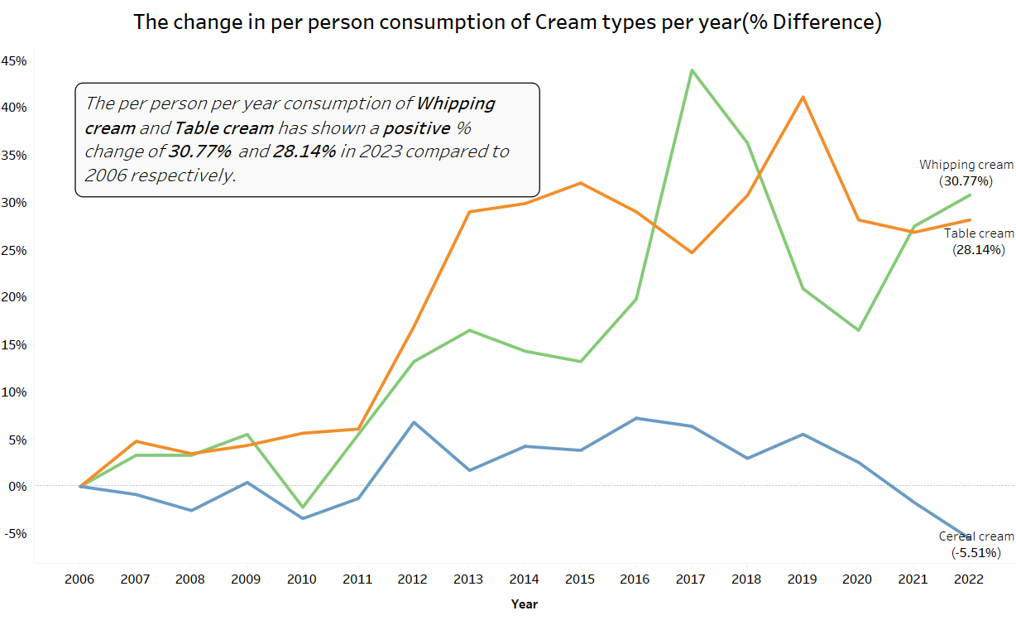
Analysis_6: Per Person consumption of different Cream product
Insights:
Table cream is the highest consumed cream product per person, while Whipping cream is the lowest.
- Over the years, per person consumption volumes have generally exhibited an increasing trend except Cereal cream.
Recommendations:
Implement focused marketing strategies to enhance the appeal and consumption of whipping cream.
Consider rebranding and adapting cereal cream products to meet evolving consumer preferences and reverse the declining trend.

Slide 9
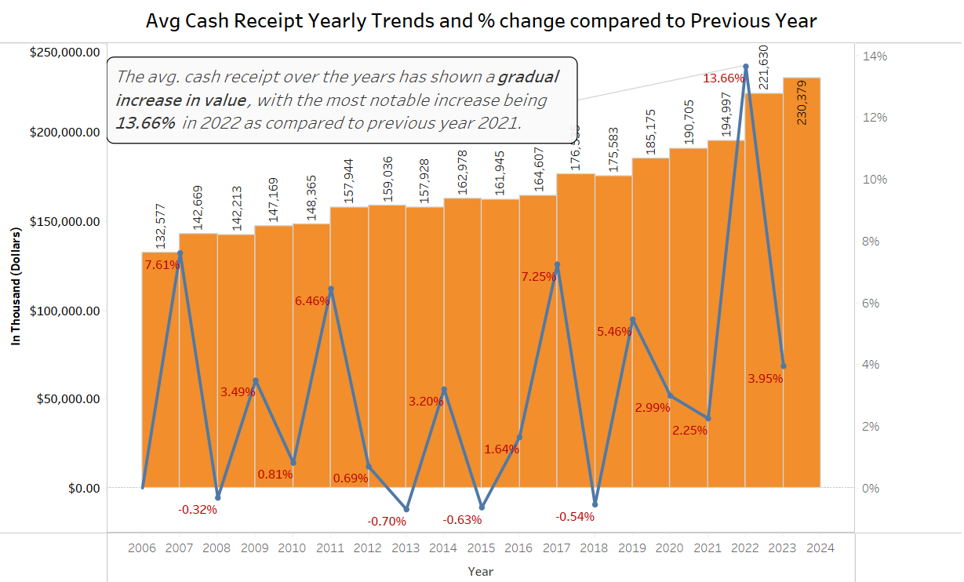
Analysis_7: Cash receipts from milk sold off farms
Insights:
The avg. cash receipts saw its most notable increase was of 13.66% in 2022 compared to the previous year, 2021.
Recommendations:
Utilize insights from the gradual increase in average cash receipts to replicate successful strategies behind the notable 13.66% growth in 2022.

Slide 10
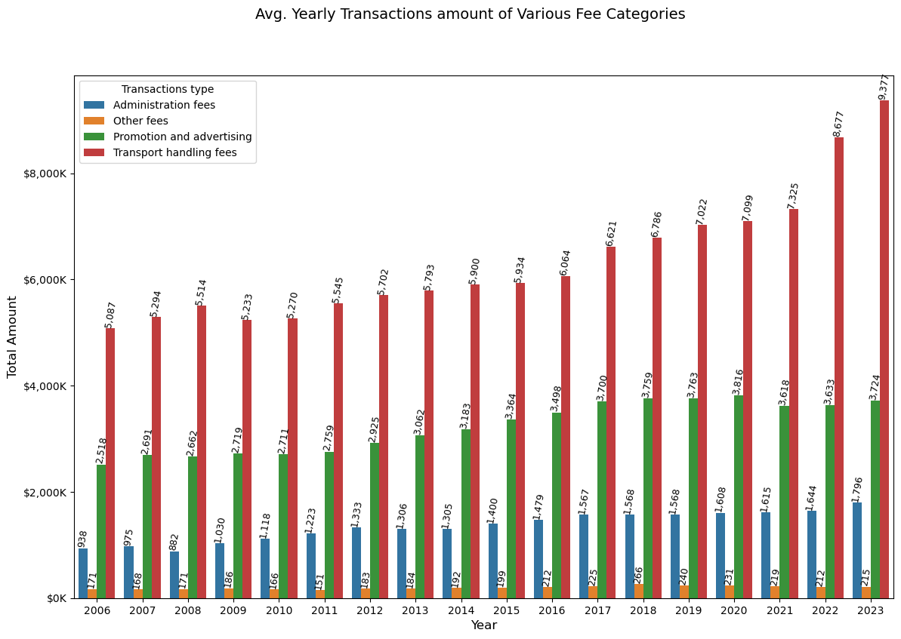
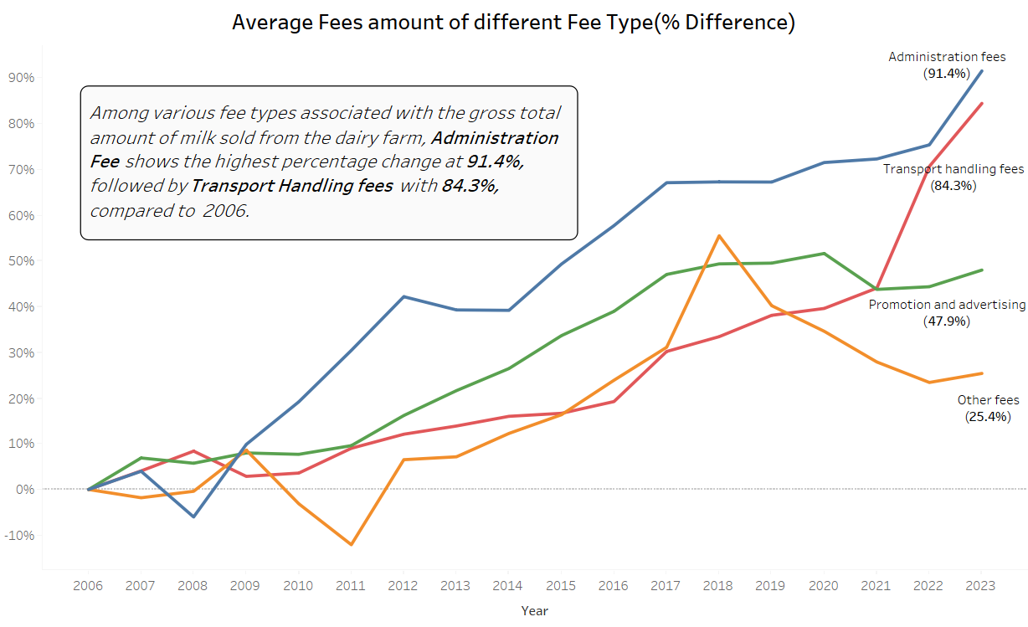
Analysis_8 : Avg. Fee amount of various Fee Types
Insights:
The major portion of additional fees is related to Transport Handling fees followed by Promotion and advertising fees.
Administration fee shows the highest % change at 91.4% compared to 2006.
Recommendations:
Optimize Transport Handling: Explore ways to streamline and reduce Transport Handling Fees for cost savings.
Promote Consumption: Implement Govt. schemes to encourage milk consumption, easing the marketing burden on farmers.

Slide 11
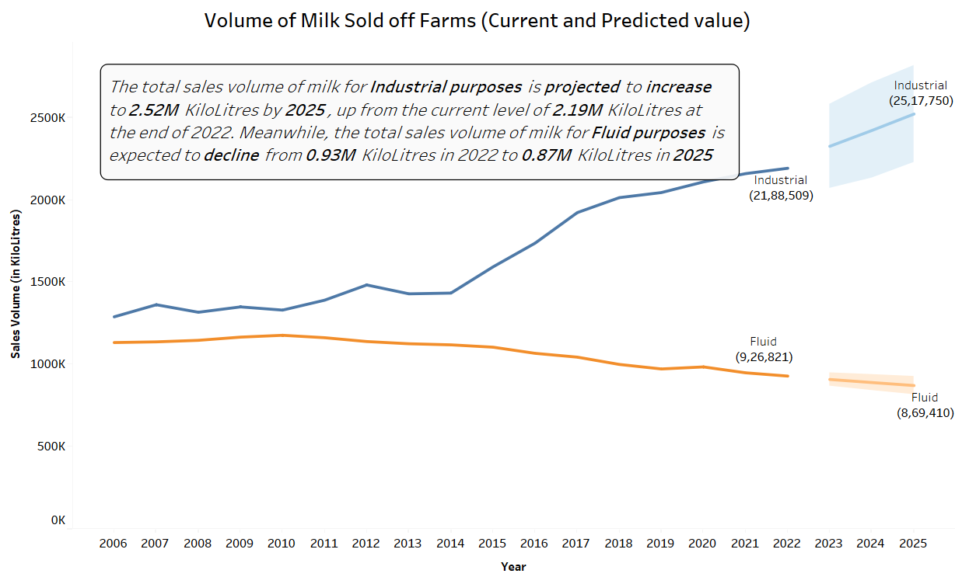
Analysis_9: Forecast the Total Sales Volume of Milk Sold off Farm
Insights:
Sales volume for Industrial purposes is projected to increase to 2.52M KL by 2025.
Sales volume for Fluid purposes is expected to decline to 0.87M KL in 2025.
Recommendations:
Industrial Production Optimization: Enhance production to meet rising industrial demand, focusing on efficient supply chain management.
Diversify Revenue: Explore strategies to offset potential profit impact from the projected decline in fluid sales volume.

Slide 12
Conclusion
Investigate and address sales slowdowns in the dairy industry.
Optimize production to meet rising industrial demand, focusing on efficient supply chain management.
Diversify revenue streams to offset potential profit impact from the projected decline in fluid sales volume.
Encourage higher consumption of popular milk and cream product for sustained growth.
Address declining trends in milk and cream types by adapting to changing consumer preferences.
Implement cost reduction measures to ensure financial sustainability.
Explore government initiatives promoting milk consumption to ease marketing burden on farmers.

Slide 13
Thank You

